Slide 1
CRAZYWIN Cricket Fantasy Android Application
Supervisor: Dr. Vipin kumar
Assosiate Professor in MCA Department

Slide 2


Team Members
Ashutosh Kumar (Team Leader)
Yash Yadav
Abhay Ranjan

Slide 3
Overview
This project is insight into the design and implementation of an Android Fantasy Application, Fantasy apps are getting so much popular now adays, and there are some features lacking in every application according to or research, so our aim is to do our best to fill that gap, which is missing in other applications.

Slide 4
Working of the Project
Users can sign up for free
Users can enter CrazyWin referral coupon code(received from other users) during the signup process and earn a certain signup bonus.
On the other hand, referrer also gets paid certain bonus amount for referring CrazyWin.
A user gets a certain budget (100 credits) while creating a new fantasy team and can be spent that budget by including player of his/her choice. Each player costs certain credits so that is where the user needs to stay within a given budget by selecting best players in a team.
Once user finalizes his/her dream team by selecting a captain and vice-captain of a team, it's time to join the available contest by paying a certain entry fee and this is the hot-spot from where CrazyWin earns most of its revenue.

Slide 5
System Requirements
1. Hardware Requirement
a. Laptop or PC
- i3 processor system or higher
- 4 GB RAM or higher
- 100 GB ROM or higher
2. Software Requirement
b. Laptop or PC
- Windows 7 or higher
- Android Studio
Android Phone (6.0 and above)

Slide 6

Features
The objective of the project is to design and develop fantasy sports software which is quite similar to Dream11.
This application provides a platform for playing fantasy Cricket, football kabaddi, etc.
It is an online game where users create a Virtual Team of players and earn points based on the performances of these players in real matches.
A user who scores the maximum points in his joined contest attains the first rank on the leader board.
Offers free and paid contests. A user has to pay a certain fee to join a contest and can win real cash.

Slide 7

Advantages
Instant Money Transfer
Lots of Entertainment
Easy to get started
Easy Money
Strong Prediction will be your key to success

Slide 8

Disadvantages
Heavy competition reduce your chances of winning.
Addiction is one of the concerning disadvantages of CrazyWin
Internet Connection is mandatory.

Slide 9
DELIVERABLES
There are 5 major things I hope to achieve with this application, which include-
I. Speed in usage
II. Easy and friendly UI
III. Privacy Protection
IV. Promoting Unity
V. Economic boost

Slide 10
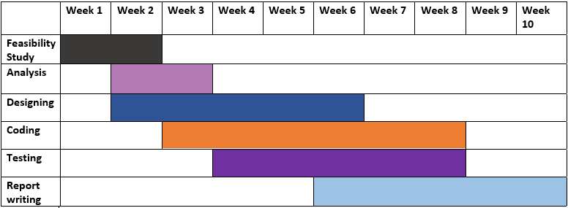
Gantt Chart

Slide 11

Thank You

